Slide 1


„Where is Circular Economy in EU going? – Challenges in Raw Materijal Recovery in the Baklan Countries
prof.dr.sc. Aleksandra Anić Vučinić
University of Zagreb
Geotechnical faculty, Environmental Engineering department
aav@gfv.hr
ISTANBUL, October 22 2021
Zagreb, 7.12.2018.

Slide 2
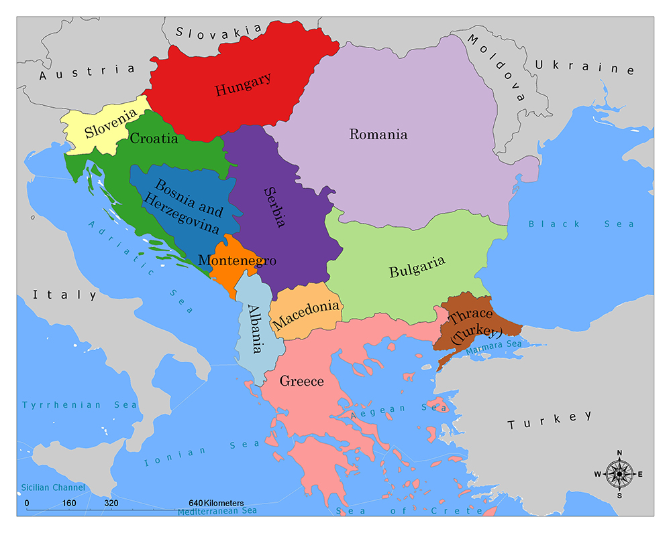
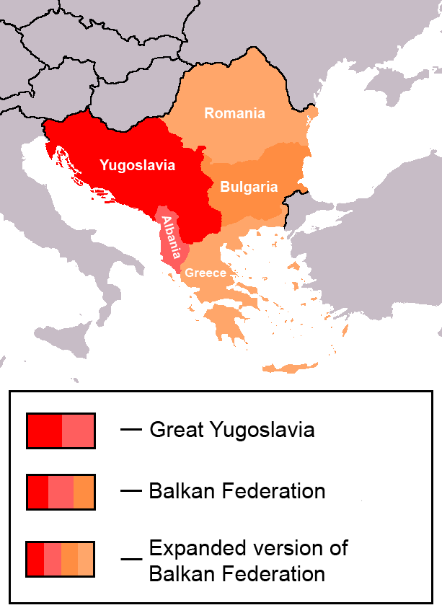
What is Balkan?
Balkans-political1 - Balkanski poluotok – Wikipedija (wikipedia.org)
SE Europe ☺
Balkan federation - Balkan Federasyonu - Vikipedi (wikipedia.org)

Slide 3
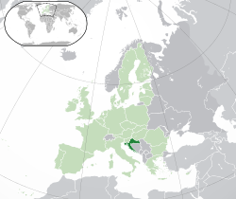
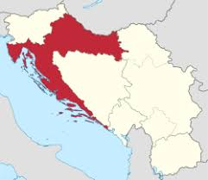
Republic of Croatia
Population: 4,284,899 (2011 census)
Total area: 56,594 km2
3,7 mil t (2015), 97% non hazardous waste
1.682.428 t MSW (2020)
8 years member of EU
414 kg/inh (2020)
41 % separate collection (2020)

Slide 4
Republic of Croatia 2020
41%

Slide 5
Circular Economy – where it is going?
Landfill Directive 1999
Global warming
Decrase of landfilling of biodegradable waste 35%
Forbiden landfilling of untreated waste
Waste Framework Directive 2008
Targets for waste prevention
Reuse centre
Separate collection
50% recycling of separates
Closing the loop - An EU action plan for the Circular Economy 2015
NEW (old?) TARGETS
EPR
50% separte collection (paper, plastic, biowaste)
55% must be recycled or recovered up to 2025
70 % recycling of construction waste
10% landfilling up to 2035
65% WEEE collected and treated
Single use products - forbiden
CHALLENGES?

Slide 6
Circular Economy – where it is going?
Landfill Directive 1999
Global warming
Decrase of landfilling of biodegradable waste 35%
Forbiden landfilling of untreated waste
Waste Framework Directive 2008
Targets for waste prevention
Reuse centre
Separate collection
50% recycling of separates
Closing the loop - An EU action plan for the Circular Economy 2015
NEW (old?) TARGETS
EPR
50% separte collection (paper, plastic, biowaste)
55% must be recycled or recovered up to 2025
70 % recycling of construction waste
10% landfilling up to 2035
65% WEEE collected and treated
Single use products - forbiden
CHALLENGES?

Slide 7
CHALLENG 1 – PUBLIC AND PRIVATE REALTION IN WMS

Slide 8
CHALLENG 1 – PUBLIC AND PRIVATE REALTION IN WMS

Slide 9
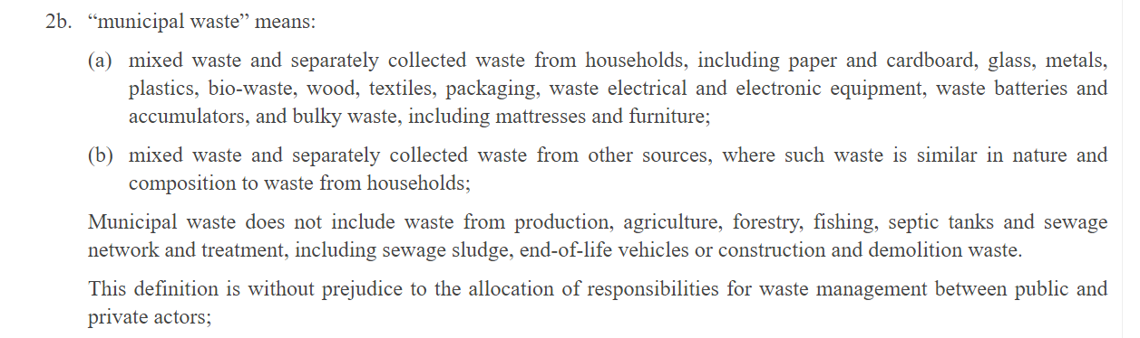
CHALLENG 2 – STATISTIC?

Slide 10
CHALLENG 2 – STATISTIC?
% SEPARATE COLLECTION- trenutno
20.000 INH, RH
KOMUNALNI OTPAD | t/g | %
OSTATNI KOMUNALNI OTPAD | 9.261 | 83,15
PAPIR | 918 | 8,24
PLASTIKA | 488 | 4,38
STAKLO | 277 | 2,48
LIMENKE | 18.5 | 0,17
TEKSTIL | 10 | 0,09
BIOOTPAD | 165 | 1,48
Ukupno | 11.138 | 100
16,84 %

Slide 11
CHALLENG 2 – STATISTIC?
% SEPARATE COLL - 2018
KOMUNALNI OTPAD | t/g | %
OSTATNI KOMUNALNI OTPAD | 9.261 | 83,15
PAPIR | 918 | 8,24
PLASTIKA | 488 | 4,38
STAKLO | 277 | 2,48
LIMENKE | 18.5 | 0,17
TEKSTIL | 10 | 0,09
BIOOTPAD (vrtni i drvo) | 165 | 1,48
EE otpad | 84 | 0,61
Otpadne baterije i akumulatori | 2 | 0,01
Glomazni otpad | 2354 | 16,99
Ostali komunalni | 220 | 1,59
Otpad od čišćenja ulica i održavanja parkova | 57 | 0,41
Ukupno | 13.855 | 100
31,15 %

Slide 12
CHALLENG 2 – STATISTIC?

Slide 13
CHALLENG 2 – STATISTIC?

Slide 14
CHALLENG 3 – END OF WASTE CRITERIA?
After recycling according to the Waste list – recyclable material is still waste
End of waste criteria???
New products with high performances – demand that producers must fulfil
There is no clear rule for end of waste criteria
RDF can’t fulfil end of waste criteria – it is waste
There is no regulation/or obligation for producers
WWTP – sludge on agricultural surface – not working in CRO

Slide 15
CHALLENG 4 – GLOBAL
COVID
Energy crysis
China ban
Cost of CE
  High cost of separate collection and sorting of MSW – can we pay that?
  EPR – high cost for consumer
  Cost of recycling (general)
  WEEE cost needed to recicle last 5% of rear earth metals?
  Global oil price?
  Climate change?
  WTE - ??? Hyearchy
  Chemical recycling?
  The ownership of the resources??

Slide 16
CONCLUSION
CE is going on (yet)
Energy recovery is comming back
End of waste criteria must be more defined
Obligation for producers to use recyclable materials in new materials
In the future – EU must redefine CE

Slide 17
Thank you ☺

